Slide 1

Modelling of the 3D environments with Drones
Verfasser: Julian Bialas,
Betreuer: Prof. Mario Döller,
Datum: 21.05.2021

Slide 2
1. Evaluation of v-Slam-Algorithms
1.1 Functionality of a V-SLAM-Algorithm shown on ORB-SLAM
1.1 Trajectory Analysis
1.2 Pointcloud Analysis
1.3 Computational Time

Slide 3
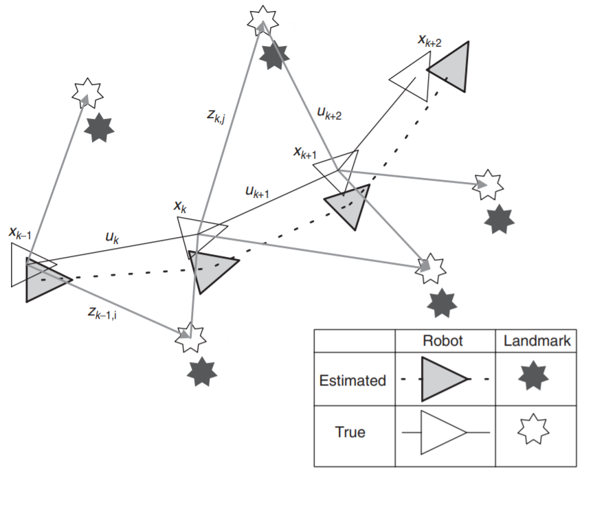
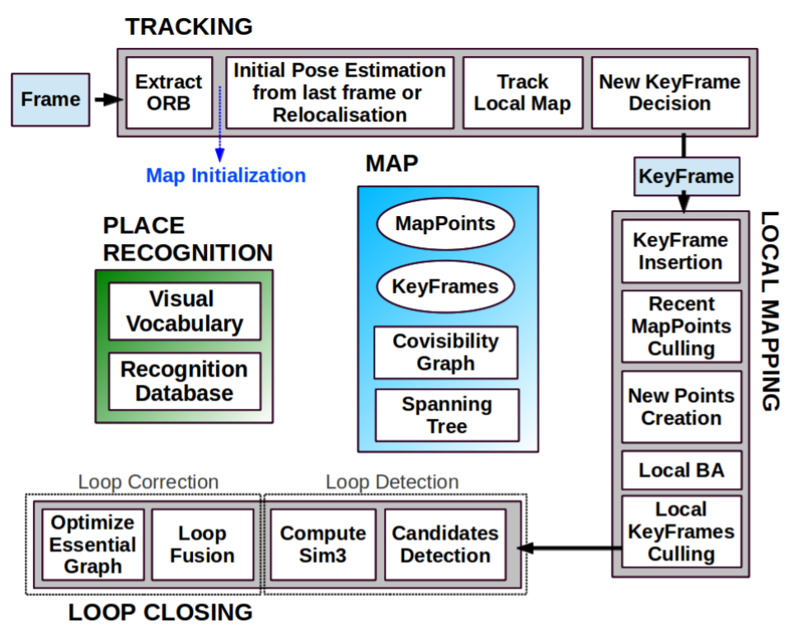
V-SLAM Algorithms
Problem Definition:
Example ORB-SLAM:

Slide 4
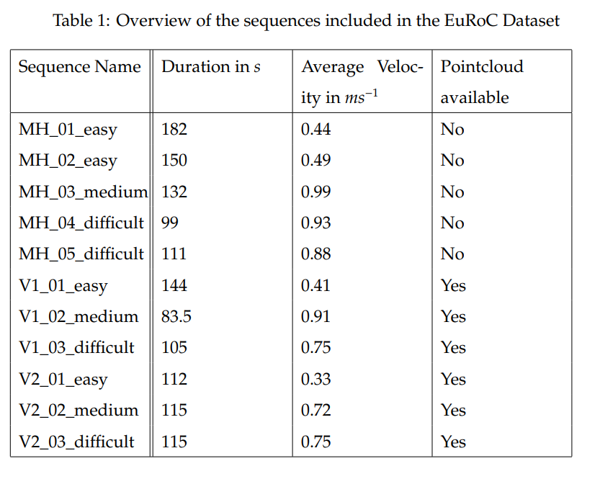
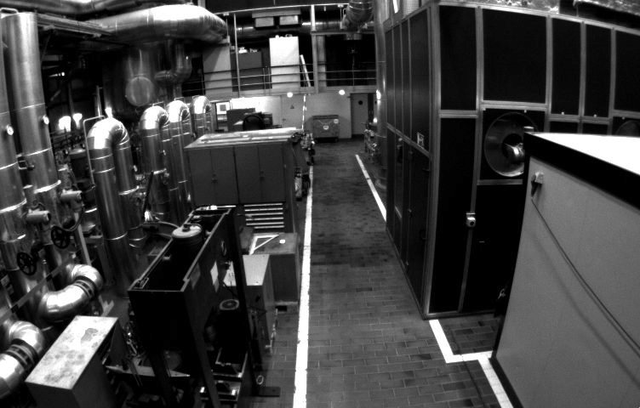
EUROC DATASET
Example frame from first sequence

Slide 5
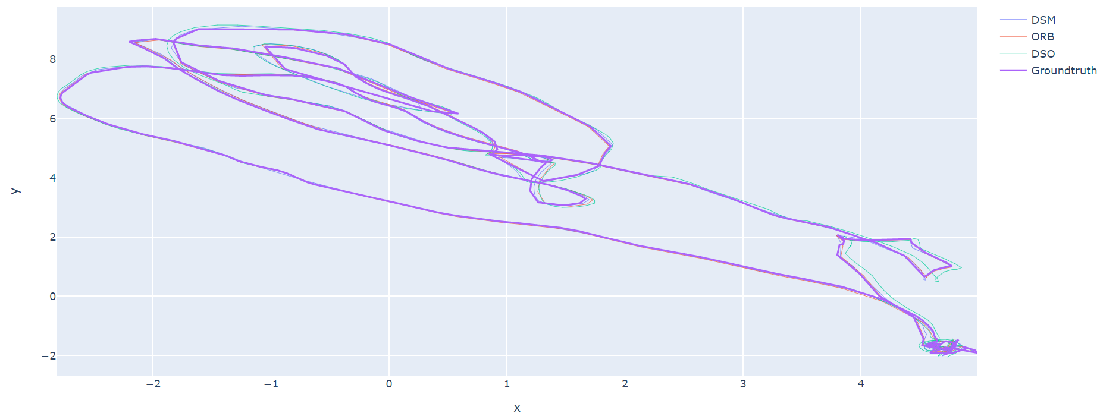
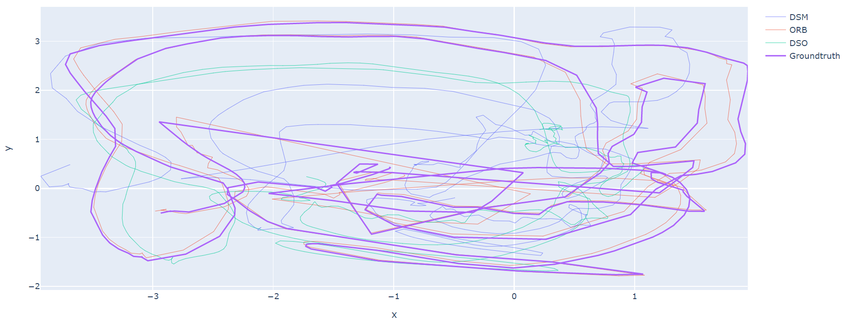
Trajectory Analysis
Flight path observation for first sequence:
Flight path observation for last sequence:

Slide 6
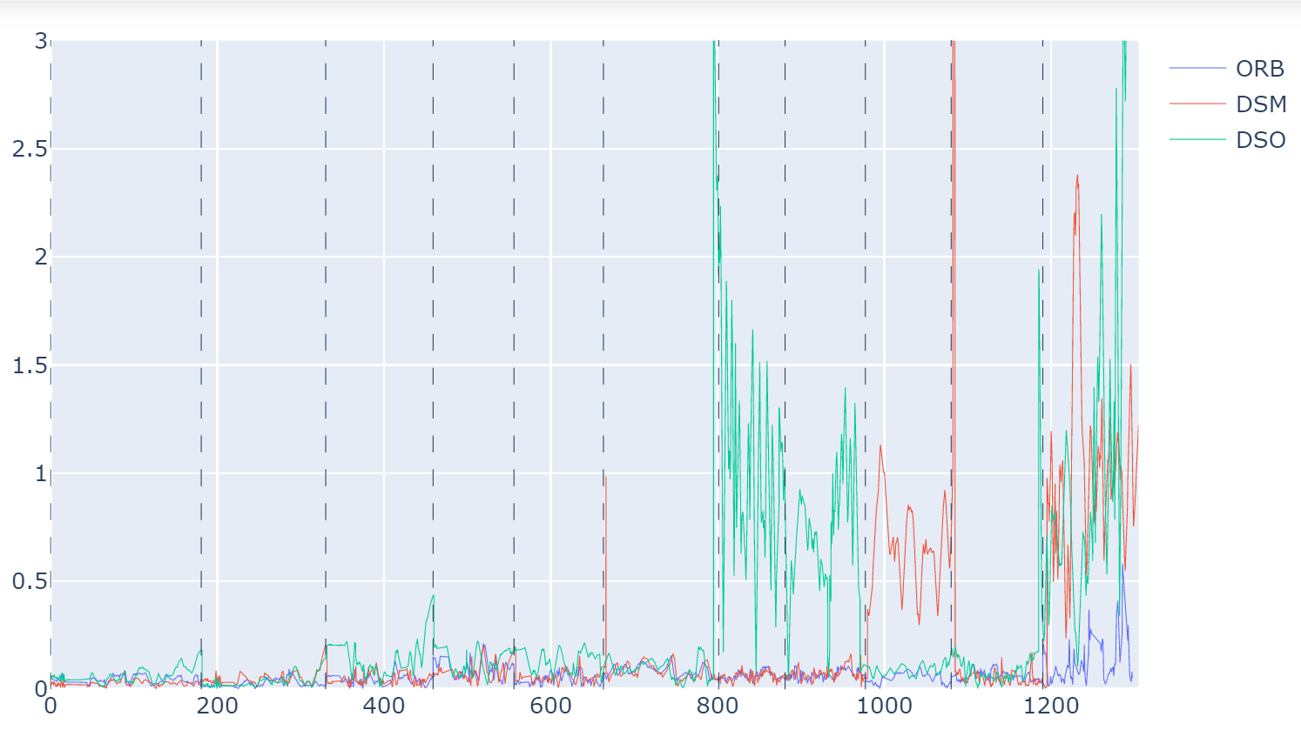
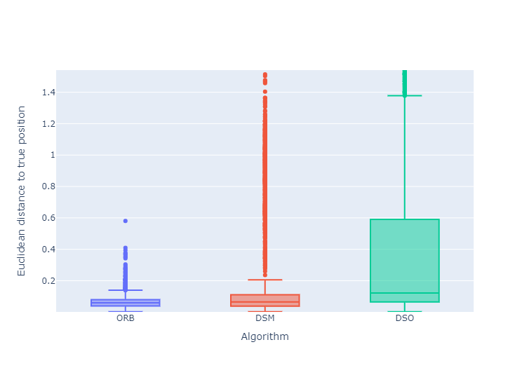
Trajectory Analysis
Distances to true positions over time:
All distances to the true positions:

Slide 7
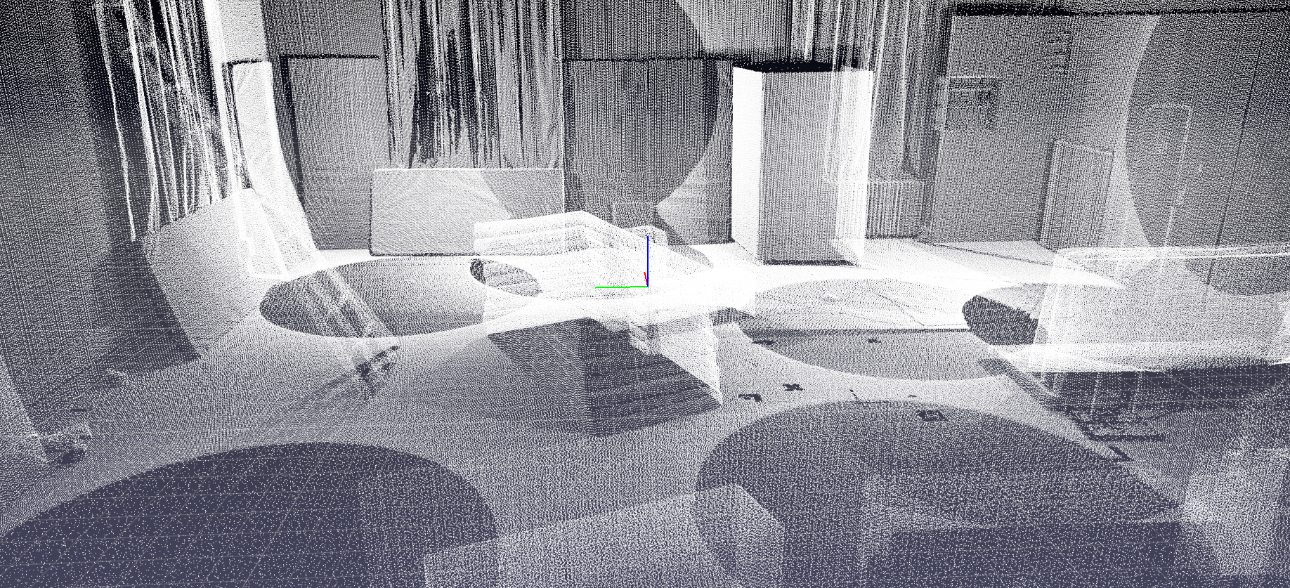
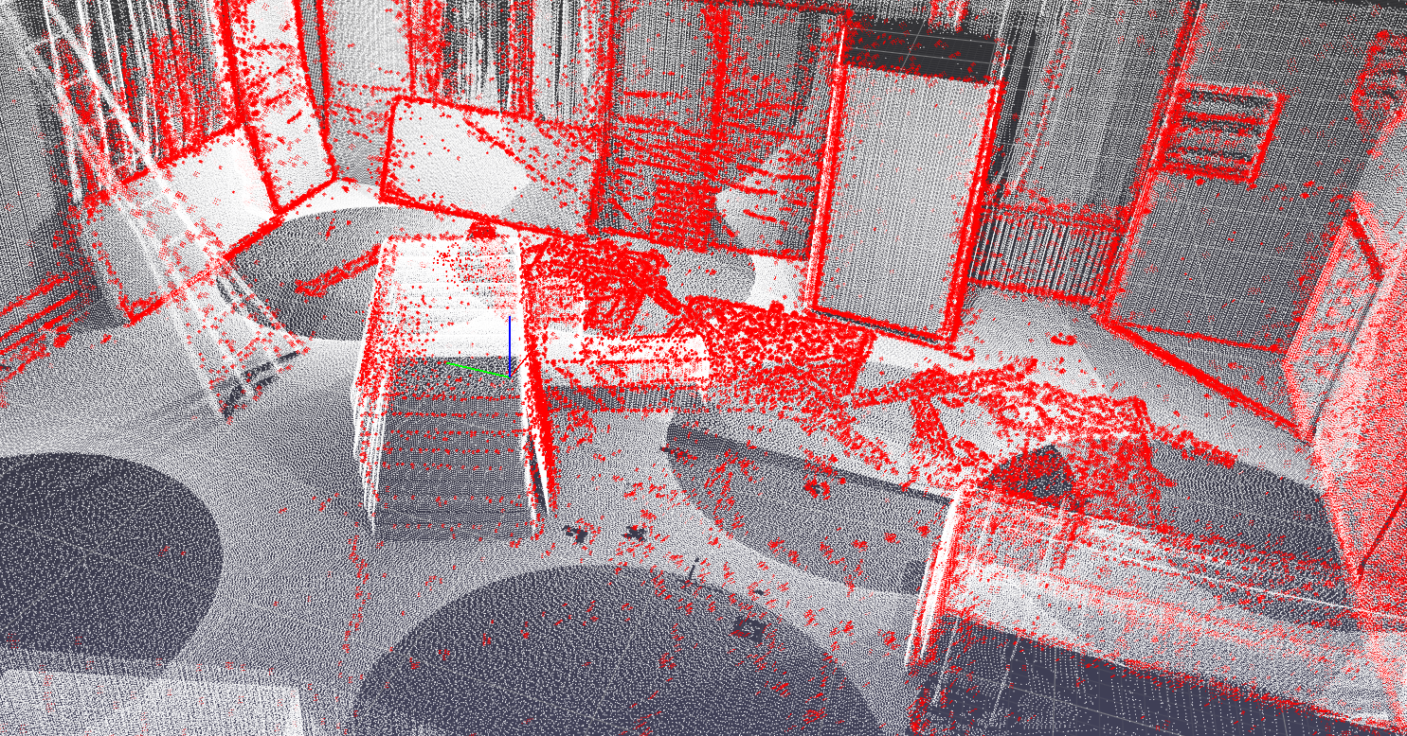
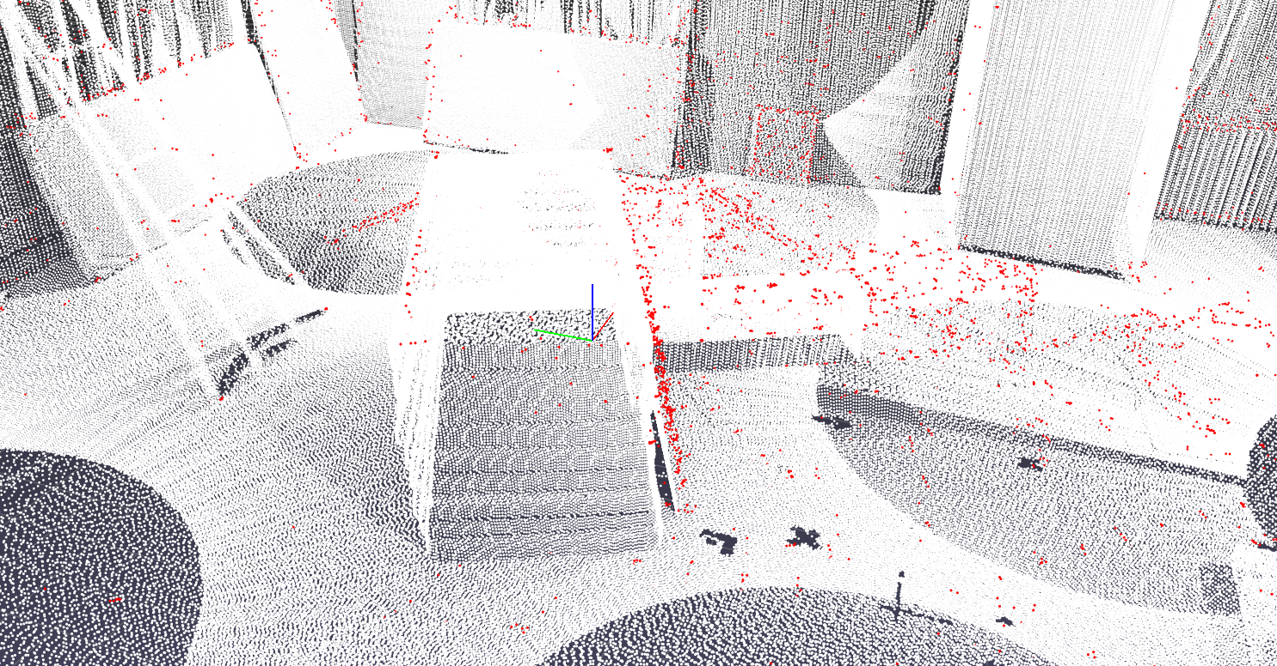
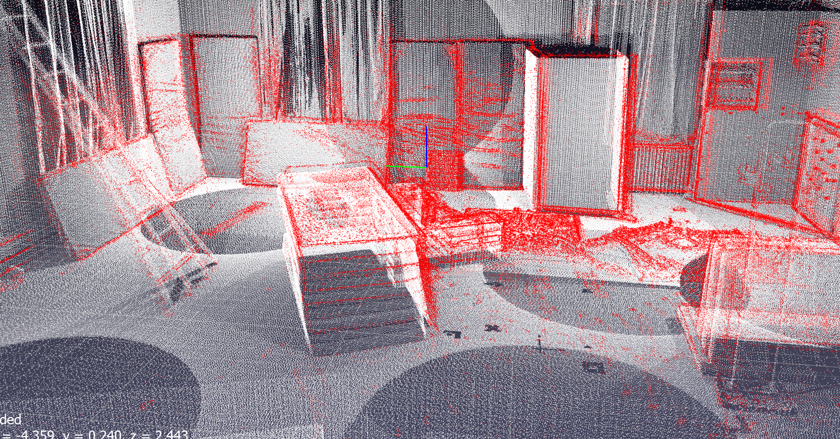
Pointcloud Analysis
Groundtruth:
DSM:
ORB:
DSO:

Slide 8
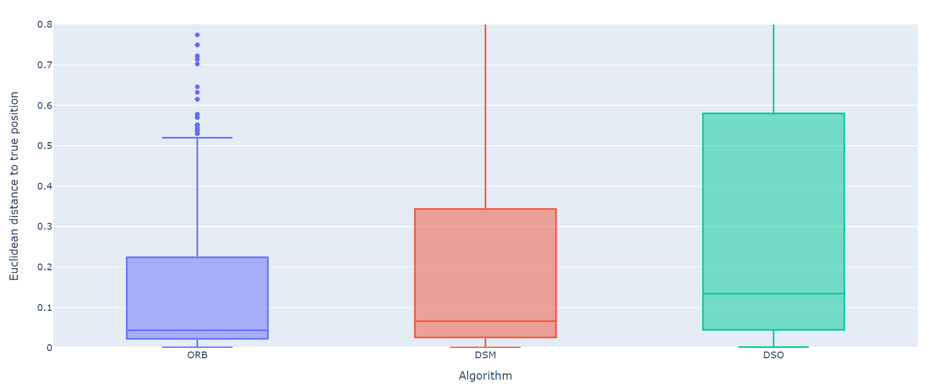
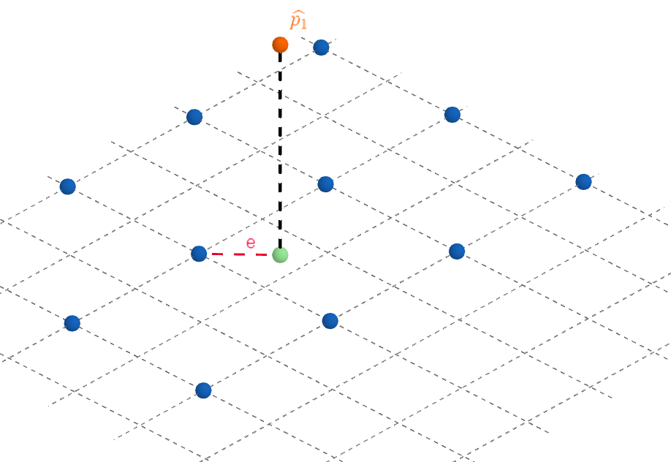
Pointcloud Analysis
Distances of evaluated points to true position
Evaluation error:

Slide 9
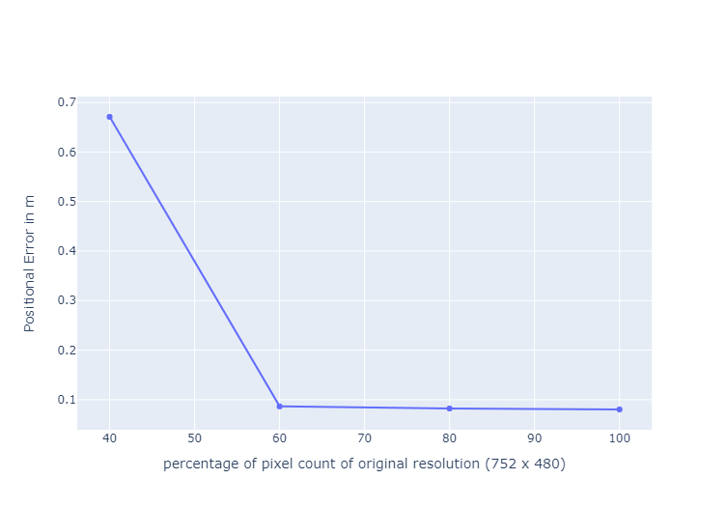
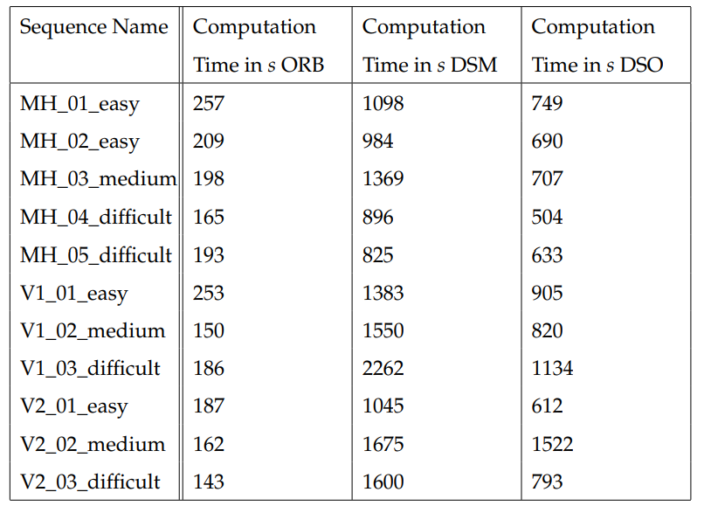
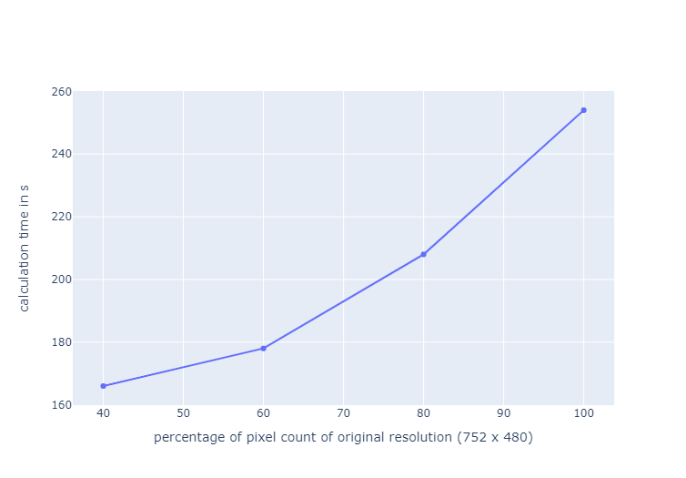
Computational Time
Influence of resolution on mean positional error:
Computational Time:
Influence of resolution on computation time:

Slide 10
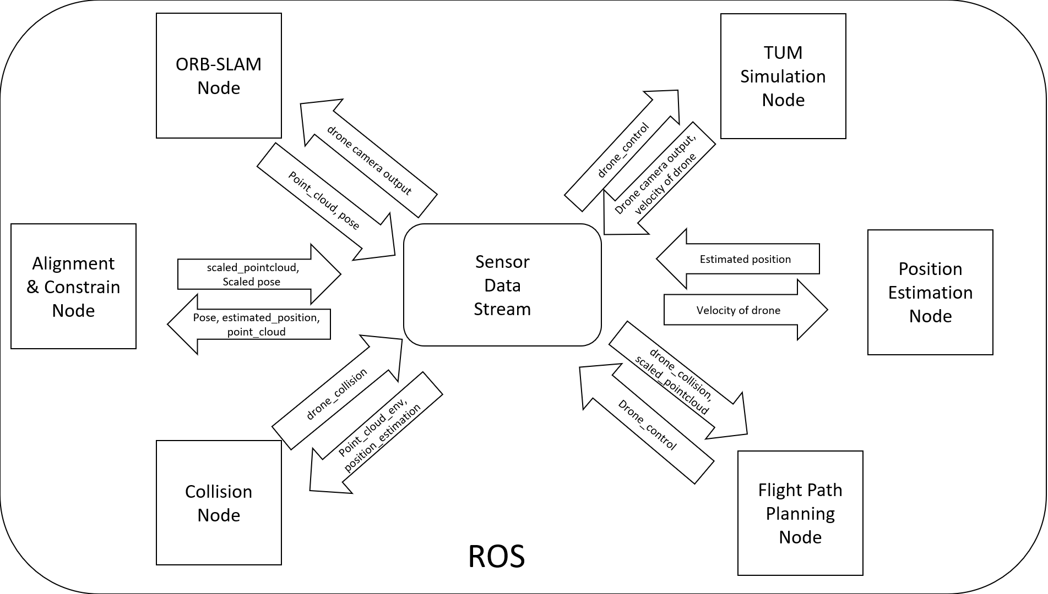
2. Simulated Environment
Overview of the ROS setup for the simulated environment :

Slide 11
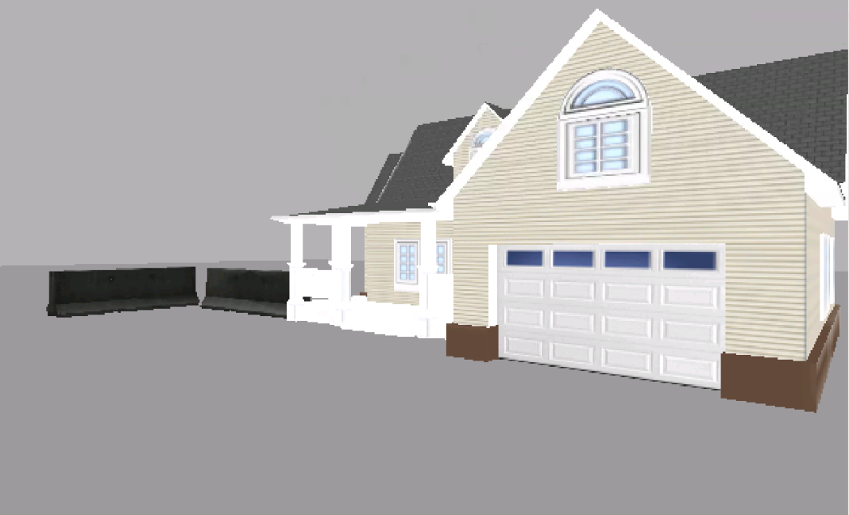
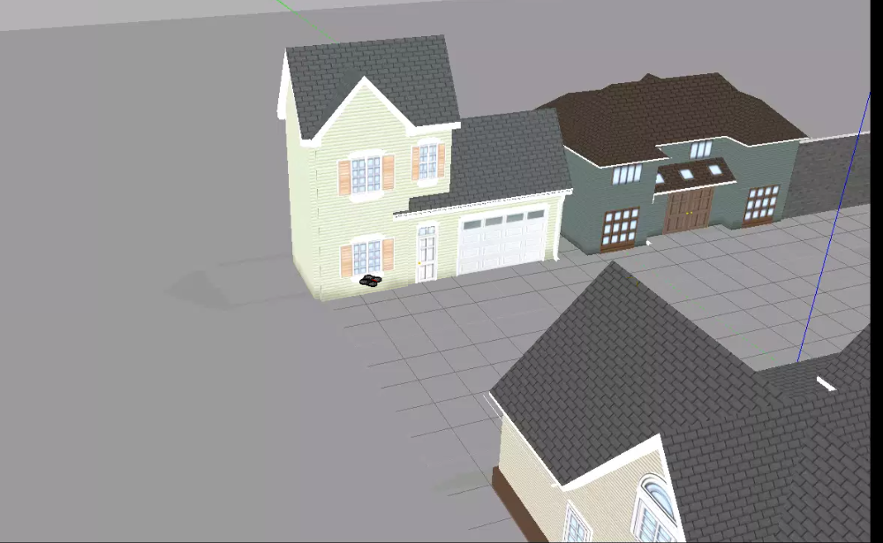
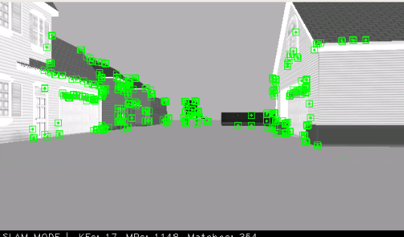
2. Simulated Environment
Camera output of drone:
Drone flying in simulated envirnment:
ORB applied:

